Slide 1

Efﬁcient Delivery From Above: A Strategic Planning Approach for Drone Food Delivery

Slide 2


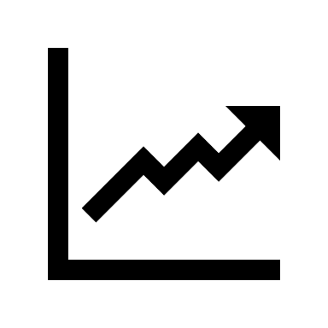

Market Overview
Online food delivery market (bn)
Orders per year (m)
The online food delivery market in India is expected to grow at a CAGR of 19% from 5.1bn to 8.8bn due to change in customer lifestyle and increased access to the internet
19%
1.8x
Growing internet penetration, rising consumption and growth in urbanization will drive market growth over a period of time
Distribution of orders received by a restaurant
Distribution of orders received by a restaurant
The total users connected to internet in India, online shoppers are yet to breach the 25% mark (v/s China’s 70%)
The online food ordering is done by only 9% of the population using internet (v/s 36% for China and 50% for the US)

Slide 3
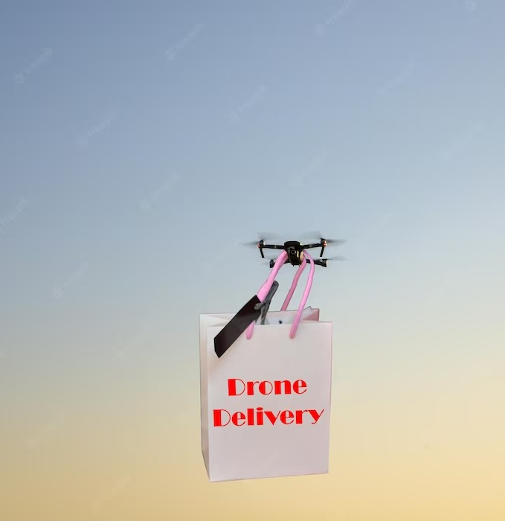








Challenges of Drone Delivery
Weather conditions
Restricted radius
Security
Food pick-up from restaurant
Very low ROI
Battery life
Regulations and policies
Real time data feed

Slide 4
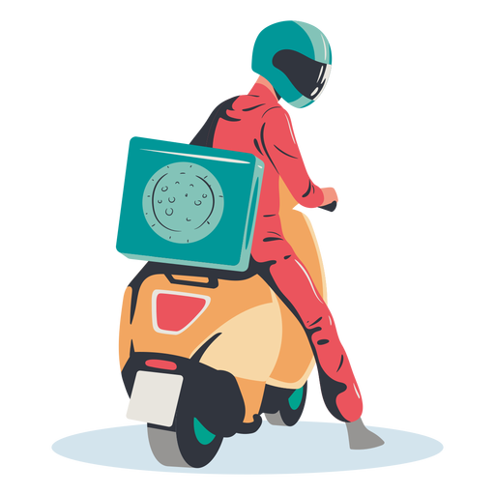

Challenges of land Delivery
Traffic congestion
Route optimization
Wrong delivery & spillage
Cost to company
Low serviceability

Slide 5
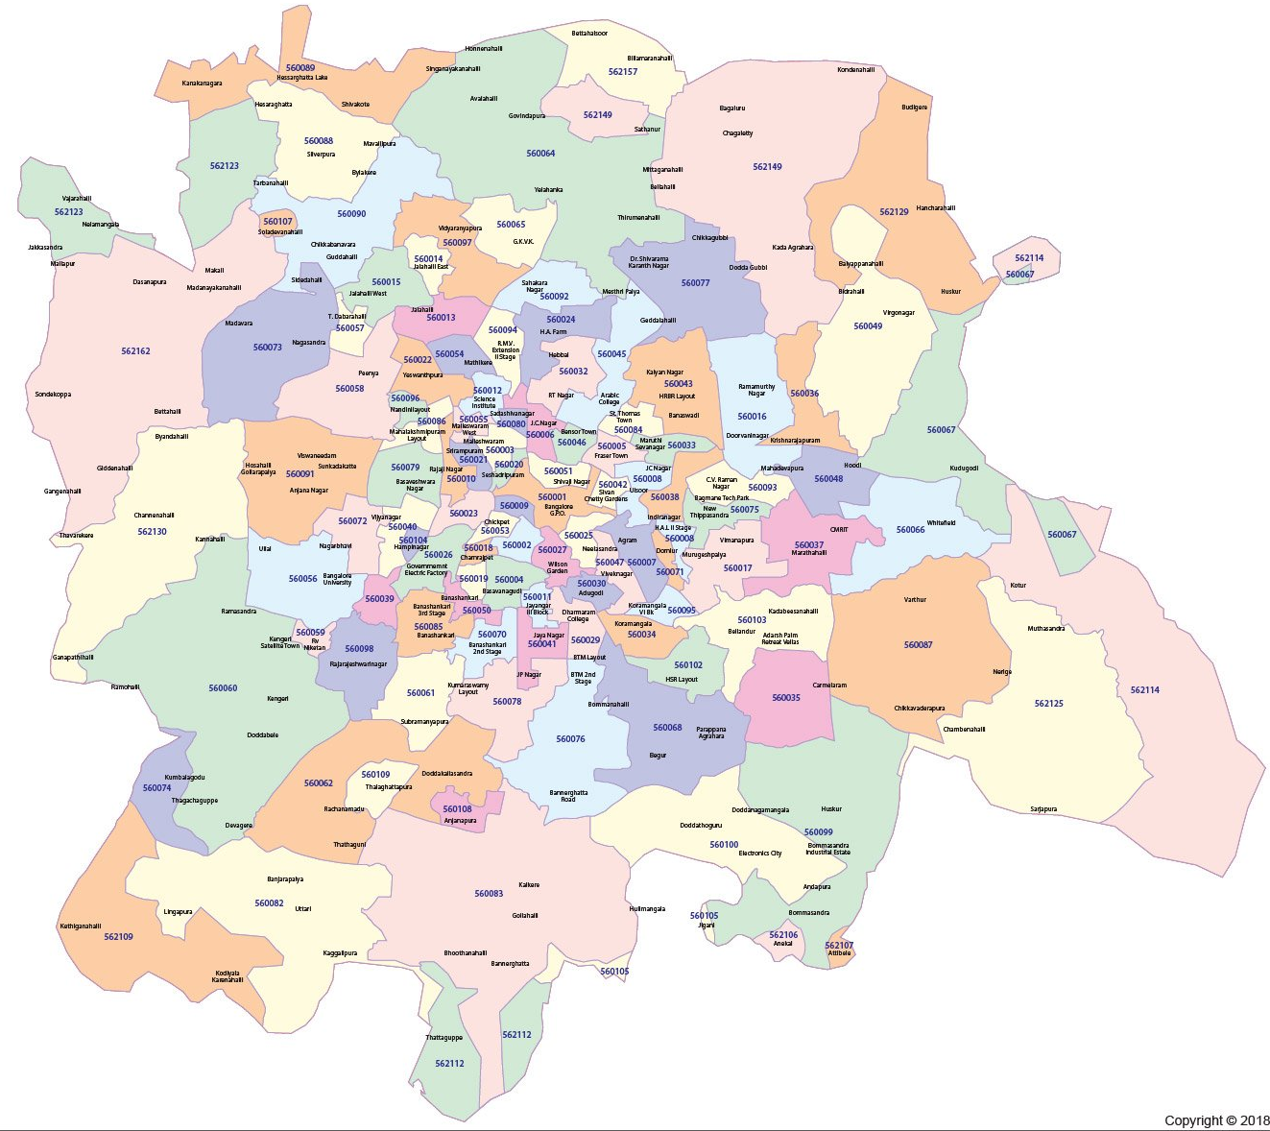

Implementation Strategies
Hub to Hub delivery
Hybrid delivery with first mile delivery by drone and last mile by delivery partner
Cloud kitchen setups
Min order cap for drone delivery
Competitive pricing and loyalty benefits
Increased incentive
Route optimization
Micro-mouse technology for better routes

Slide 6

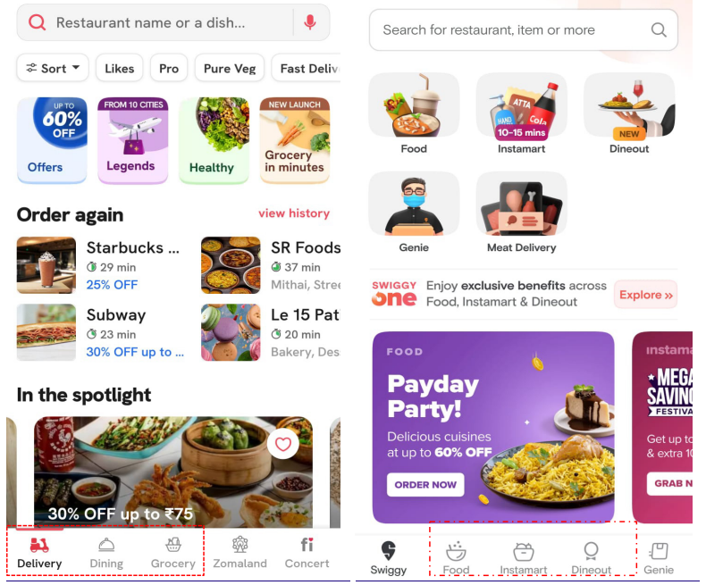



Competitive Landscape
Zomato has aggressive pricing (INR 149 for three months) v/s Swiggy One (INR 299/399 for three months based on usage patterns.
Zomato is expanding into new markets, while Swiggy aims to dominate the current market. As a result, Swiggy has experienced a decline in market share to Zomato in the past two years.
1
Pricing
2
Expansion
Zomato started its business from restaurant advertisement revenue while Swiggy started with food delivery service
Since Zomato and Swiggy would share orders, increased city-level competition in India is expected to slow down profitability and postpone the benefits of expanding client bases over the next years
3
Business
4
User base
Key operating metrics of Zomato and Swiggy (1HCY’22)
 | Zomato | Swiggy
Restaurants (‘000) | 207 | 262
Delivery Partners | 341 | 300
Cities | 1,000 | 562
Revenue (USD m) | 660 | 648
GOV (USD m) | 2,518 | 2,300
Take rate (%) | 26 | 28

Slide 7
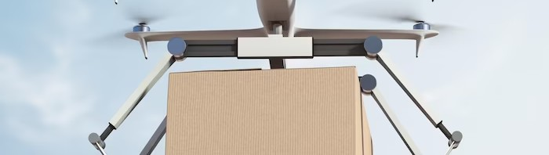
Drone Specifications
Technical features
Autonomous flight feature
Outdoor navigation system
GPS & Visual sensing
3D obstacle sensing
Return to home feature
150-300 ft
7-8 km
50 kmph
30 Minutes

Slide 8
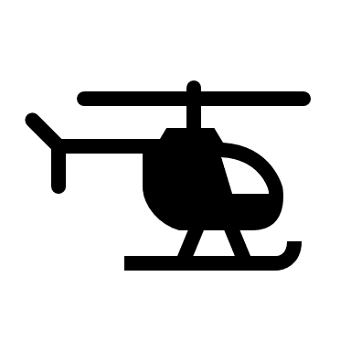
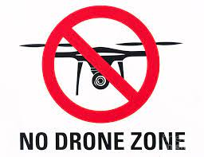
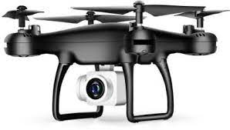

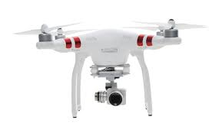

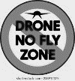

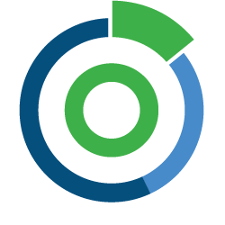
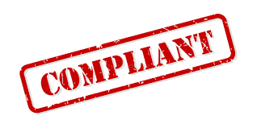



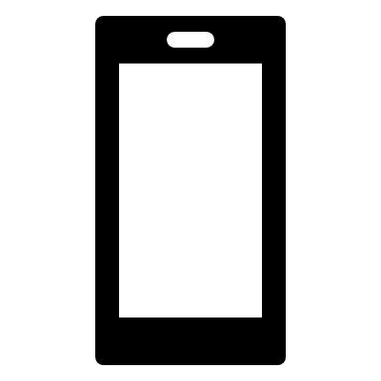


Regulatory Landscape
https://drone-laws.com/drone-laws-in-india/
Remote pilot certificate
No fly zone
Be aware of Airspace Restrictions/ No Drone Zones
Operate an unmanned aircraft system only if a person has a certificate and are registered on the Digital Sky platform
Avoid flying the drone over or close to military bases, government buildings, or other no-drone zones and inform concerned authorities of any incidents
When using small to medium-sized drones up to 2 kg for non-commercial drone use, no certificate is necessary
Drones shouldn't be flown higher than 400 feet (120 metres) off the ground
Remote Pilot Certificate
Subscription Management
No fly zone
Issuance of UIN number
Fly in visual line of sight (VLOS)
“No Permission- No Takeoff” (NPNT) Compliant
Unmanned Aircraft Operator Permit (UAOP) from DGCA for commercial operations
Flight permission every time
Flight permission every time
Safety Measures
Safety measures
Obtain Permission before each flight through the Digital Sky Platform
Interference can be from mobile devices or blockage of signals, pay attention when flying your drone
Without submitting a flight plan or obtaining AAI/ADC approval (at least 24 hours prior to the actual operation), drone operators must not fly in regulated airspace near airports
Avoid flying drone over a group of people, public events, or stadiums full of people without permission
Avoid visiting airports and heliports

Slide 9
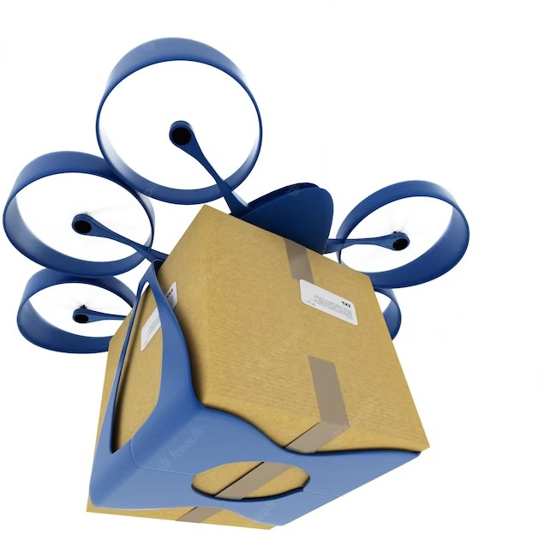
Conclusion
Drone food delivery has the potential to revolutionize the delivery industry by offering faster and more efﬁcient service. While there are challenges to overcome, the beneﬁts outweigh the risks. As technology continues to advance and regulations become more favorable, we can expect to see an increase in the use of drones for food delivery.

Slide 10
Thank you! Do you have any questions?

